Slide 1
Bovine Arch Influences Re-Coarctation Rates in the Era of Extended End-to-End Anastomosis
Midwest Pediatric Cardiology Society Madison, WI
September 15-16, 2016
Nicholas B. Cavanaugh¹, Brian D. Conway¹, Osamah Aldoss², Ben E. Reinking², Nicholas P. Rossi¹, Ahmed El-Hattab¹ and Joseph W. Turek¹
Divisions of Pediatric Cardiac Surgery¹ and Pediatric Cardiology,² University of Iowa Children’s Hospital, Iowa City, Iowa

Slide 2
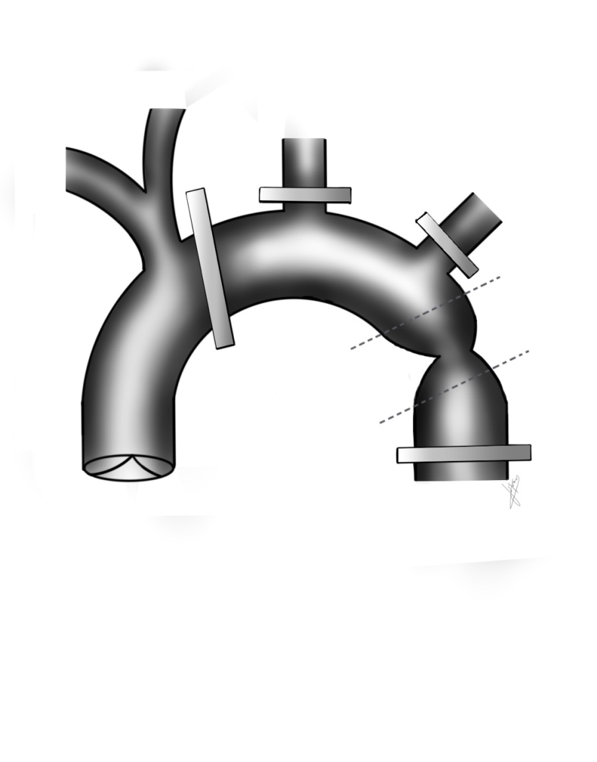
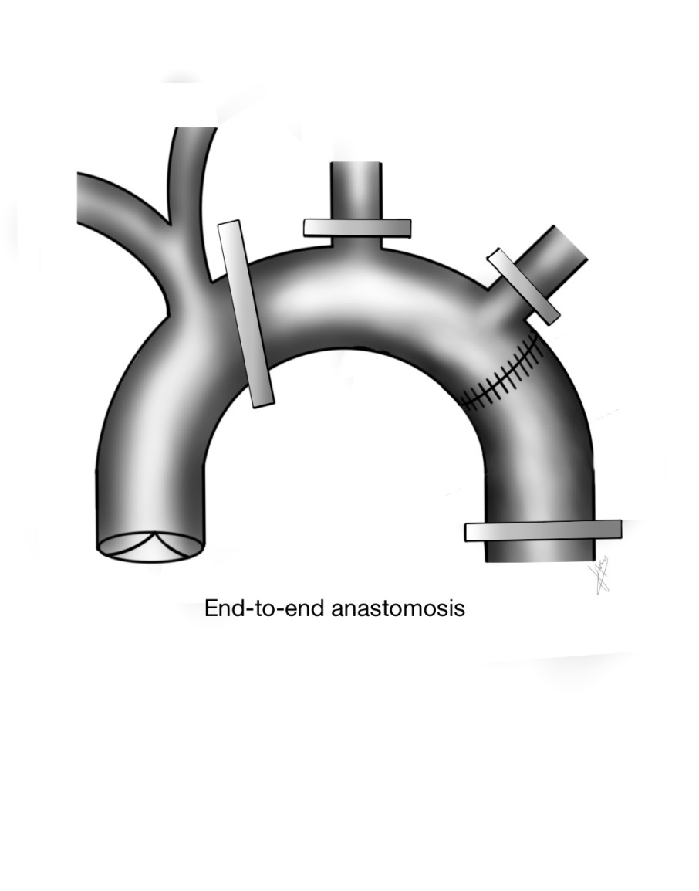
Aortic Coarctation Repair
End-to-End Anastomosis

Slide 3
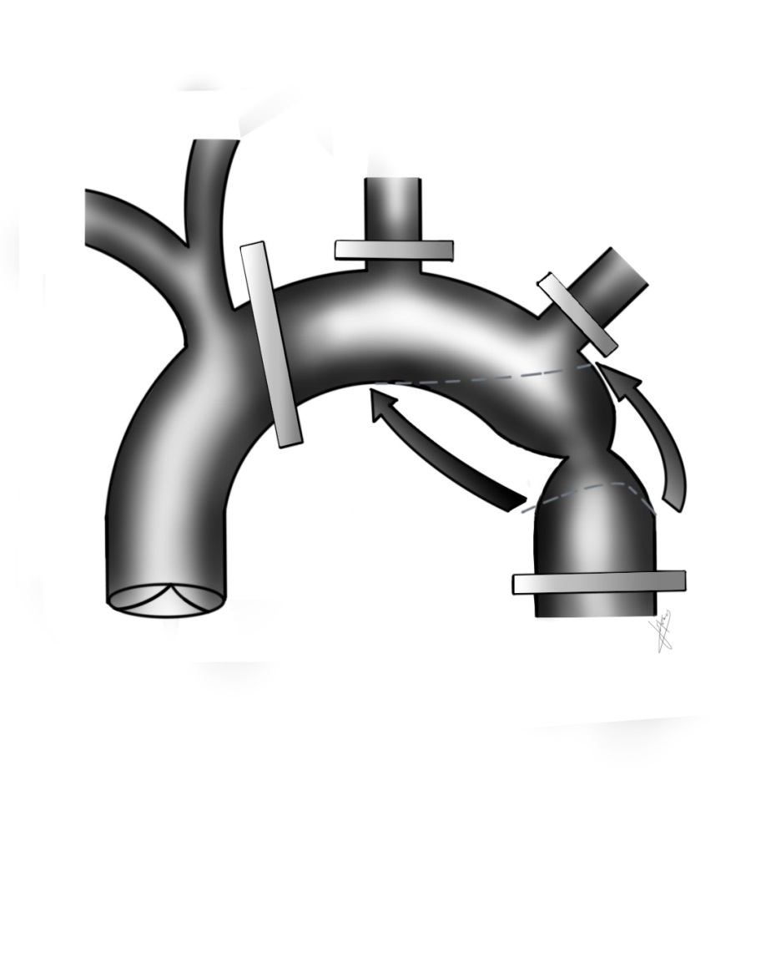

Aortic Coarctation Repair
Extended End-to-End Anastomosis

Slide 4
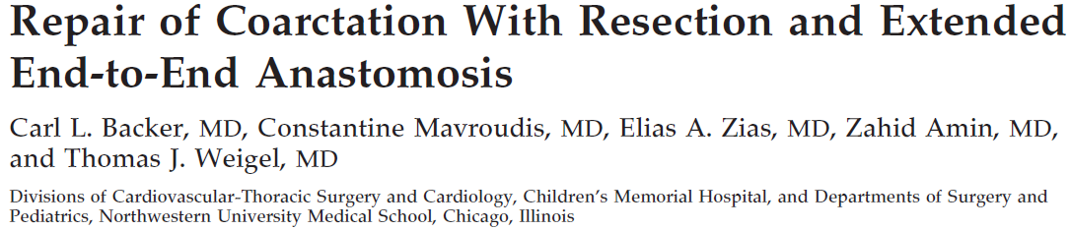
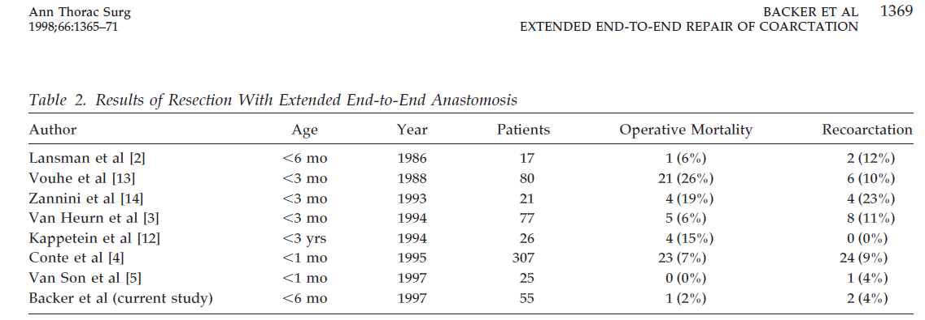
Aortic Coarctation Repair

Slide 5
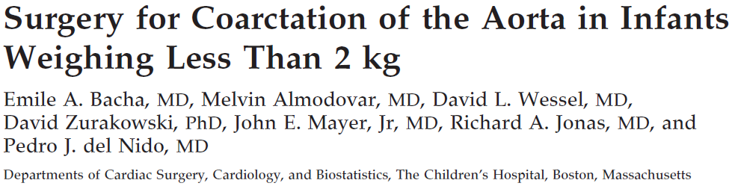
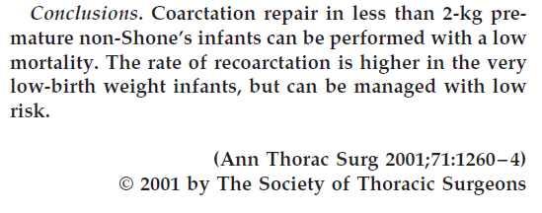
Aortic Coarctation Repair

Slide 6
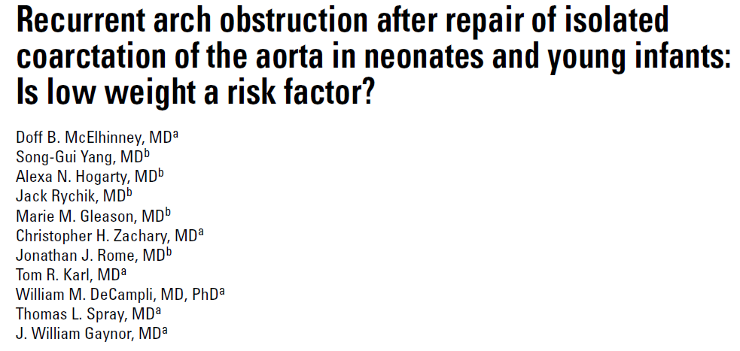
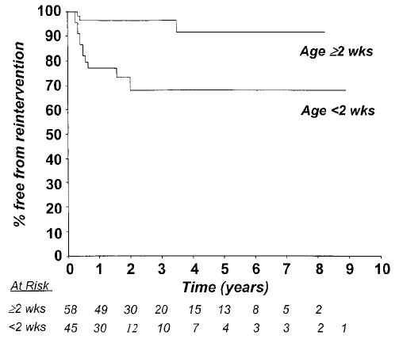
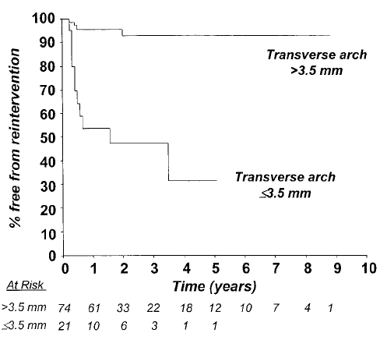
Aortic Coarctation Repair

Slide 7
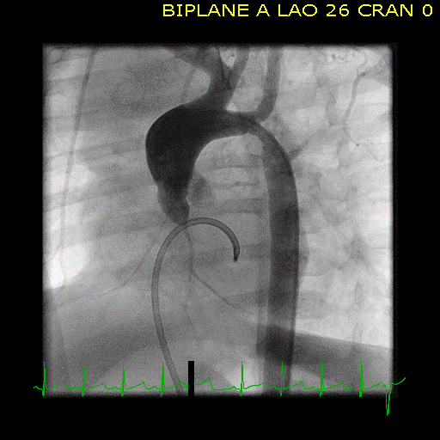
Bovine Aortic Arch
AKA:
Bicarotid trunk
Common brachiocephalic trunk

Slide 8
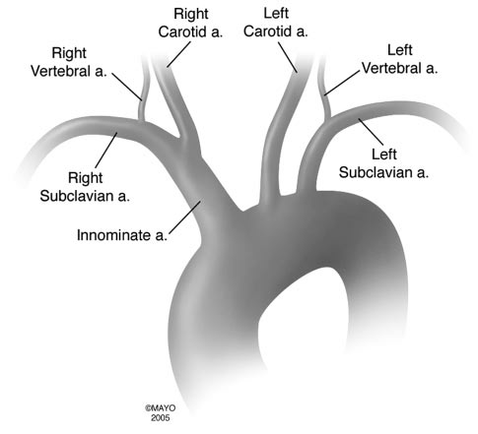
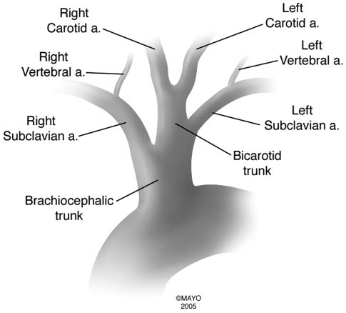
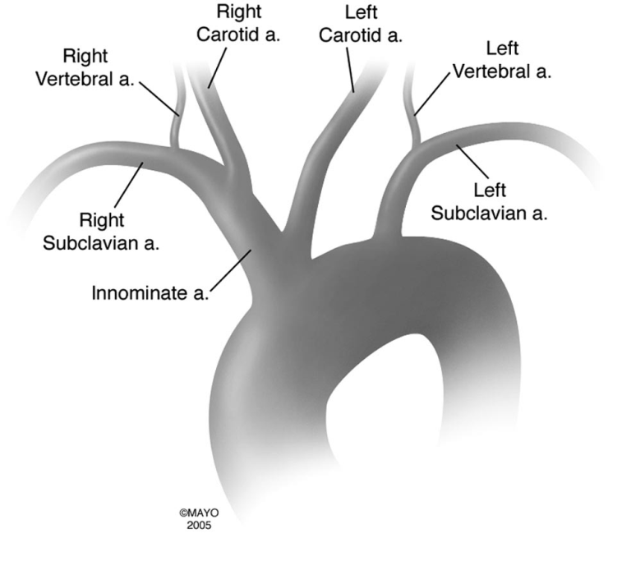
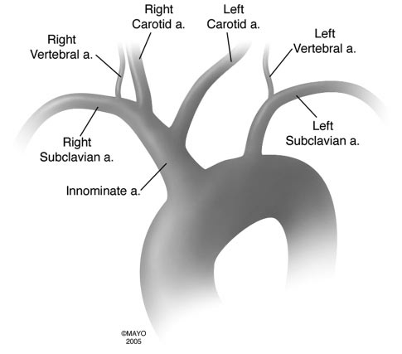
Bovine Aortic Arch

Slide 9
Bovine Aortic Arch
No study has shown a
bovine arch to be a risk factor in re-coarctation

Slide 10

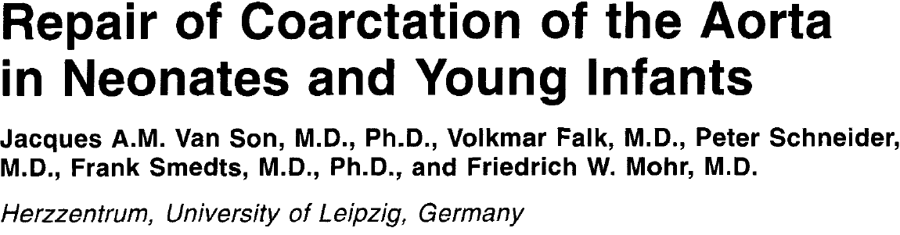
Bovine Aortic Arch
Only a few papers look at bovine arch as a variable in re-coarctation
Cohort bovine arch
prevalence = 3%
Cohort bovine arch
prevalence = 4%
Cohort bovine arch
prevalence = 5%

Slide 11
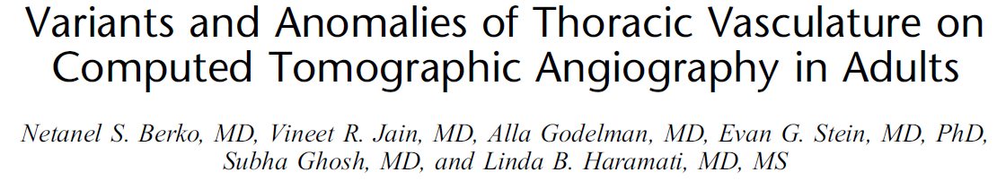
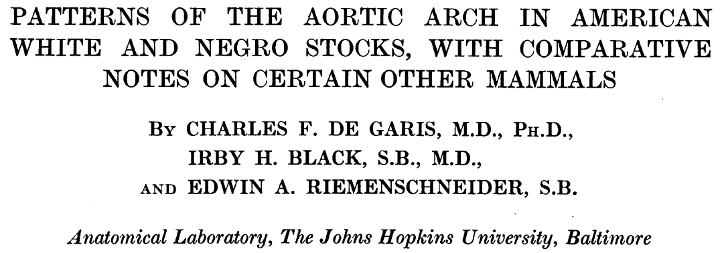
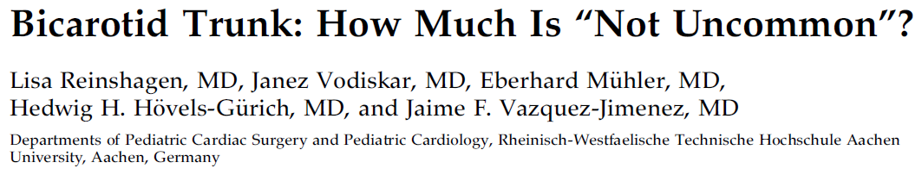

Bovine Aortic Arch
Imaging studies of bovine arch prevalence
Cohort bovine arch
prevalence = 27.4%
African American bovine arch
prevalence = 37.4%
Caucasian bovine arch
prevalence = 15.3%
Bovine arch
prevalence = 15.2%
Bovine arch in patients with aortic coarctation = 17.6%

Slide 12
Hypotheses:
1. Bovine arch anatomy is underreported on echocardiographic reports.
2. Re-coarctation rates after extended end-to-end repair are higher in bovine arch anatomy than in standard anatomy arches.
3. A diminished “clampable” distance predisposes bovine arches to re-coarctation.

Slide 13
Methods
49 patients undergoing extended end-to-end coarctation repair via a left thoracotomy over a 6 year period (2007-2012)
Echo images specifically reviewed for arch anatomy and compared to a chart review of echo reports looking at the same
Recurrent arch obstruction (echo gradient across the repair ≥20 mm Hg) assessed across arch anatomies
For cases with angiographic images (pre- or post-op), a scaled distance (clamping index) between the left subclavian artery and ideal proximal clamp location was calculated and compared across arch anatomies

Slide 14
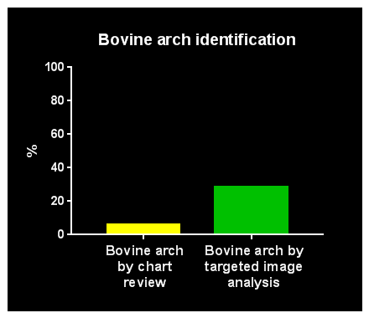
Results
28.6%
6.1%

Slide 15
Results
Patient and operative characteristics
Variableª | Normal Arch (n=35) | Bovine Arch (n=14) | P Value
Demographics
- Age, d | 96 (4-5176) | 40.5 (6-2645) | 0.47
- Weight, kg | 10.3 ± 10.1 | 7.6 ± 7.5 | 0.37
- Male sex | 24 (68.6) | 9 (64.3) | 0.76
Diagnosis
- Genetic syndrome | 2 (5.7) | 0 | 0.36
- Hypoplastic arch | 5 (14.3) | 2 (14.2) | 0.99
Operation
- Clamp time, min | 23 (12-39) | 21 (7-40) | 0.38
ªContinuous variables are displayed as median (range) or mean ± standard deviation
as appropriate; categorical variables are presented as frequency (percentage).

Slide 16
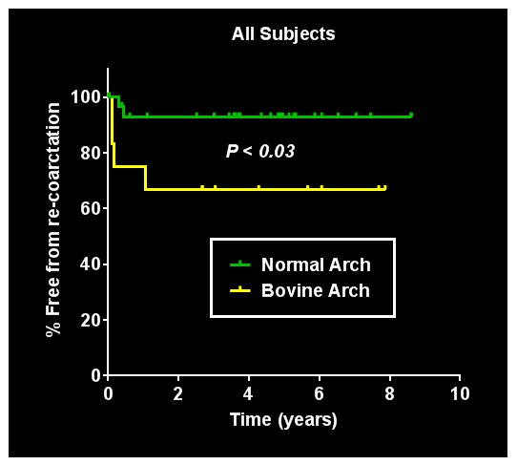
Results

Slide 17
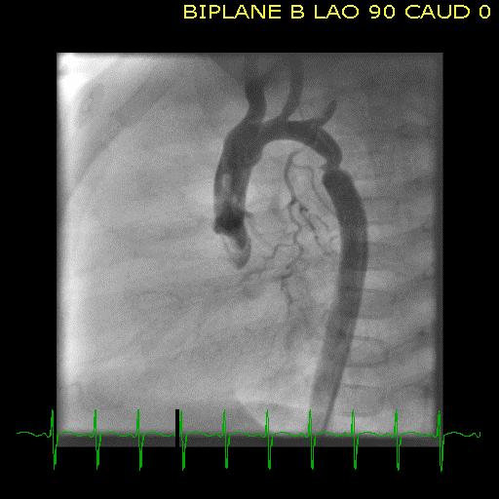

Clamping Index
B = Clampable distance immediately after the brachiocephalic trunk to the proximal side of the left subclavian artery
A = Aortic diameter at sinotubular junction
Clamping Index (CI) = $\frac{B}{A}$
B
A

Slide 18
Clamping Index (CI)
NORMAL ARCH
Mean CI = 1.31
SD = 0.55
BOVINE ARCH
Mean CI = 0.80
SD = 0.39
P<0.05
Bovine arch anatomy decreases “B” thereby limiting the amount of clampable distance.
This essentially converts an extended end-to-end anastomosis to an end-to-end anastomosis.

Slide 19
Conclusions
Bovine arches are frequently undocumented on preoperative imaging assessment and in the literature on coarctation repair
Patients undergoing an extended end-to-end repair with bovine arch anatomy have higher re-coarctation rates
A possible explanation for these findings may be a reduced available clamping distance in patients with bovine arches
These data could have profound impact on preoperative imaging assessment, parental counseling and surgical approach

